Slide 1
Oracle Developer 2000
Oracle Forms & Reports
July 12, 2010

Slide 2
Topics covered
  Introduction to Forms
  Form Components
  Form Builder Components
  Components of Form Module
  Types of Form
  Details of Form Module Components
  How to Create a New Form

Slide 3
Introduction
What is Form ?
Form is nothing but input/data entry screens given by Oracle Corporation through which we can enter data into the database.

Slide 4
Form Components
Forms Builder: Used to create a form.
Forms Compiler: Required to compile the file created in Forms Builder & creates a binary file.
Forms Runtime: Used to run the compiled code.

Slide 5
Form Builder Components
Form Module
Primary Object created using form builder is a form. It’s a collection of objects such as blocks, canvas, frames, items & triggers.
Menus
Collection of objects such as menu items, sub menu items & PL/SQL code blocks.
PL/SQL Libraries
Collection of PL/SQL functions & procedures stored in a single library file. This library file is attached to a form/menu module. All other objects in the form/menu can now access & share the collection of PL/SQL functions & procedures.
Object Libraries
Provides an easy method of creating & storing reusable objects & enforcing standards.
Database Objects
Stored Procedures, Stored Functions & Database Triggers.

Slide 6
Form Module Components
Blocks : Blocks are logical containers & have no physical interpretations. Only the items contained in a block are visible in the data block.
Items : Objects contained in blocks. It serves as container of data. An item is always associated with a block.
E.g. Text Item, Display Item, List Item, Button, Check Box, Radio Group.
Frames : A graphic object that appears on a canvas. Frames are used to arrange items within a block.
Canvas : The background on which Items, Texts & Graphics or Frames are placed. Items of a block can be placed in different Canvas-Views.
Window : Every new form is automatically held in a Window. For each Window created, at least one canvas view must be created.
PL/SQL Code Blocks : Different Triggers.

Slide 7
Types of Form
Form : Horizontal display of data based on single table
Tabular :Tabular display of data based on single table.
Master/Detail: Combination of both form & tabular display based on more than one table.

Slide 8
Details of Form Module Components
What is Block ?
Block is nothing but logical container of the table.
Types of Block
Data Block : Base Table Block
Control Block : Non Base Table Block

Slide 9
Details of Form Module Components - Canvas
What is Canvas ?
A canvas is a surface--inside a window container--on which you place the interface items and boilerplate objects that end users interact with when they run the form.
Types of Canvas
Content :- When building an application, one of the first steps is to create content canvases that will be displayed in the windows of your form(s). While you can assign more than one content canvas to the same window at design time, at runtime only one content canvas is displayed at one time in the window.
Stacked :- Stacked canvases are displayed in a window along with the window's content canvas(es) and any number of other stacked canvases. You can set the bevel, color, and pattern attributes of a stacked canvas to make it look different than the underlying content canvas. Contrarily, you can make the stacked canvas look like the content canvas, and then show and hide the stacked canvas programmatically so end users are unaware that a separate canvas is being displayed.

Slide 10
Canvas - Contd.
Horizontal Toolbar :- Specifies the canvas that should be displayed as a horizontal toolbar on the window. The canvas specified must be a horizontal toolbar canvas (Canvas Type property set to Horizontal Toolbar) and must be assigned to the current window by setting the Window property.
Vertical Toolbar :- Specifies the canvas that should be displayed as a vertical toolbar on the window. The canvas you specify must be a vertical toolbar canvas (Canvas Type property set to Vertical Toolbar) and must be assigned to the current window by setting the Window property.
Tab :- A tab canvas, made up of one or more tab pages, allows you to group and display a large amount of related information on a single, dynamic canvas object. Like stacked canvases, tab canvases are displayed on top of a content canvas, partly obscuring it. Tab pages each display a subset of the information displayed on the entire tab canvas.

Slide 11
Details of Form Module Components - Window
What is a Window ?
A window is a runtime container for all visual objects that make up a Form Builder application, including canvases. A single form can include any number of windows. While every new form automatically includes a default window named WINDOW1, you can create additional windows as needed by inserting them under the Windows node in the Object Navigator.
Types of Window:-
Document :- Document windows typically display the main canvases and work areas of your application where most data entry, and data retrieval is performed.
Dialogue :- Dialog windows are free-floating, containers typically used for modal dialogs that require immediate user interaction.

Slide 12
Details of Form Module Components – Interface Items / Controls
Text Item :- A text item is an interface control that displays and allows editing of text. The text is displayed in a field in either single or multi-line format.
Display Item :- Display items are similar to text items with the exception that display items only store and display fetched or assigned values. Display items are generally used as graphic or as conditional text.
Check Box :- A check box is a two-state control that indicates whether a certain condition or value is on or off, true or false.
List Box :- A list item is a list of text elements that can be displayed as either a poplist, Tlist, or combo box. A list item displays a fixed number of elements. Each element in a list is a text string up to 30 characters long. At runtime, you can programmatically evaluate, add, or remove list element.
Radio group / button :- A radio group is an interface control that displays a fixed number of options that are mutually exclusive. Each option is represented by an individual radio button.
Push Button :- Buttons are interface items that end users select to execute commands or initiate actions. Buttons can be used to initiate navigation, display LOVs, invoke an editor or window, commit data in a form, issue a query, or perform almost any other operation that can be coded with PL/SQL.

Slide 13
Details of Form Module Components – Relation
What is Relation ?
A master-detail relation is an association between two data blocks—a master block and a detail block. The relation reflects a primary-key to foreign-key relationship between the tables on which the blocks are based.
Types of Relations :-
Cascading :- Whenever the data from master block is deleted data from detail block will get deleted automatically.
Isolated :- Data from the master & detail block can be deleted separately.
Non Isolated :- Data from master block can’t be deleted without deleting the data from detail block.

Slide 14
Details of Form Module Components – LOV & Record Group
What is LOV & Record Group ?
Every list of values (LOV) is associated with a specific record group. The LOV is the interface object that allows operators to view, scroll, and select the records stored in the underlying record group. When you define an LOV at design time, you must specify the record group on which the LOV will be based.
When you create an LOV, you can also create the underlying record group directly from the Create LOV dialog.
Types of LOV :-
Static :- List of value based on predefined/fixed values.
Dynamic :- List of value based on record group.

Slide 15
Details of Form Module Components – Alert
What is Alert ?
An alert is a modal window that displays a message notifying the operator of some application condition.
Use alerts to advise operators of unusual situations or to warn operators who are about to perform an action that might have undesirable or unexpected consequences.
There are three styles of alerts: Stop, Caution, and Note. Each style denotes a different level of message severity. Message severity is represented visually by a unique icon that displays in the alert window.

Slide 16
Details of Form Module Components – Form Trigger
What is Form Trigger ?
Triggers are blocks of PL/SQL code that are written to perform tasks when a specific event occurs within an application. In effect, a Form Builder trigger is an event-handler written in PL/SQL to augment (or occasionally replace) the default processing behavior. Every trigger has a name, and contains one or more PL/SQL statements. A trigger encapsulates PL/SQL code so that it can be associated with an event and executed and maintained as a distinct object.
When Form Builder responds to an event by executing the code in a trigger, that trigger is said to have "fired." Most form applications include numerous triggers that fire in response to a variety of events.
A trigger must be attached to a specific object in the form, either an item, a block, or the form itself. The object to which a trigger is attached defines the scope of the trigger, and so helps Form Builder decide which trigger to fire when the corresponding event occurs. Not all triggers are relevant to all objects. For example a When-Button-Pressed trigger would not be attached to a display item.

Slide 17
Details of Form Module Components – Form Trigger Contd.
What is Form Trigger ?
    Form Level Trigger: Triggers associated with form
    Block Level Trigger: Triggers associated with block
    Item Level Trigger : Triggers associated with items.

Slide 18
Details of Form Module Components – Form Trigger Contd.
Types of Triggers
Block Processing Trigger: - e.g. When-clear-block, when-create-record etc
Interface Event Trigger: e.g. When-button-pressed, when-checkbox-changed etc
Key Triggers: e.g. key-Fn, Key-Others
Master Detail Triggers: e.g. on-check-delete-master, on-clear-details etc.
Message Handling Triggers: e.g. on-error, on-message etc.
Mouse Event Triggers: e.g. when-mouse-click, when-mouse-double click
Navigational Triggers: e.g. pre, post & when for form, block and item
Query Time Trigger: e.g. pre-query, post -query etc.
Transactional Triggers: e.g. On-close, on-commit etc
Validation Triggers:e.g. When-validate-item, when-validate-record etc.

Slide 19
How to Create a New Form
How to Create a New Form
    Using Data Block Wizard
    Build a New Form Manually
    Build a Form based on a Template

Slide 20
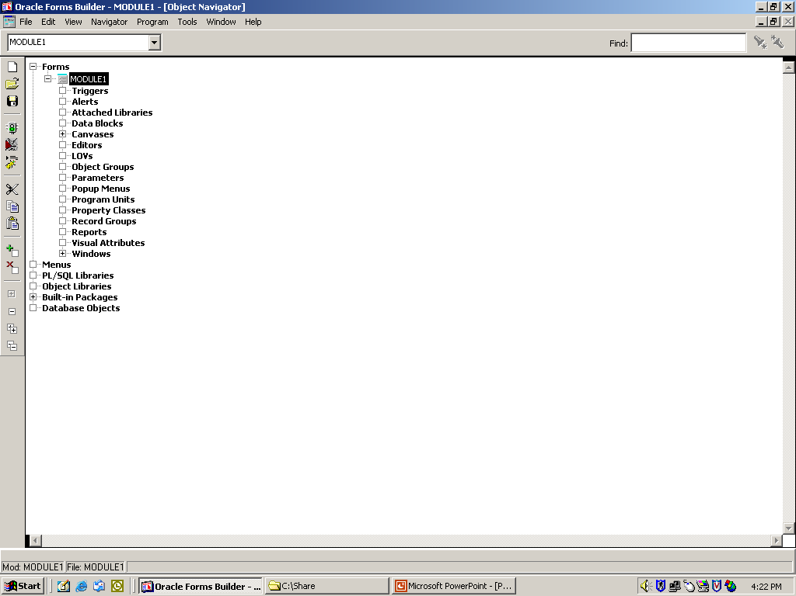
Create New Form using Data Block Wizard

Slide 21
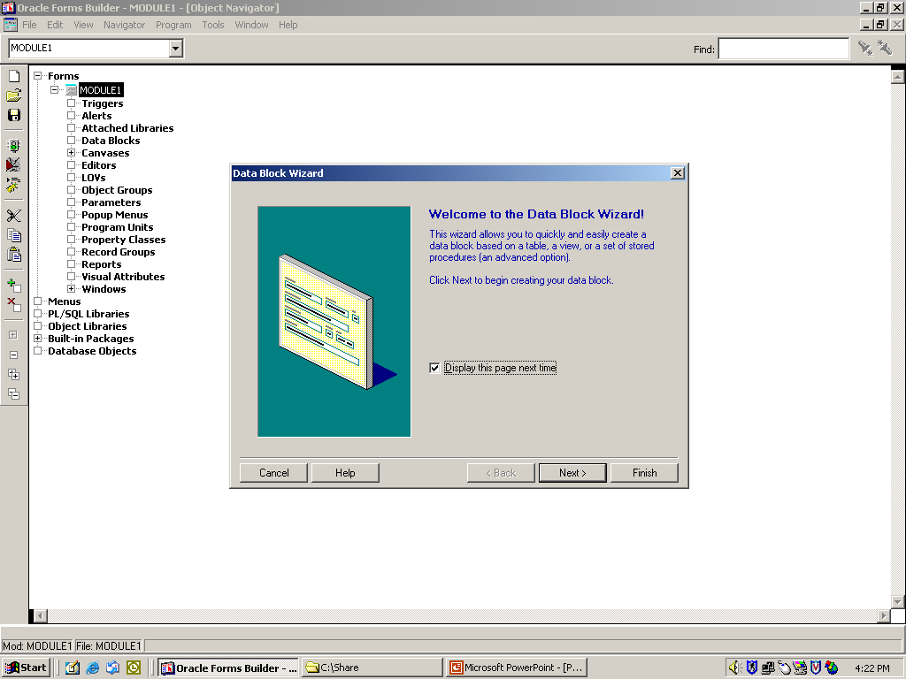
Create New Form using Data Block Wizard

Slide 22
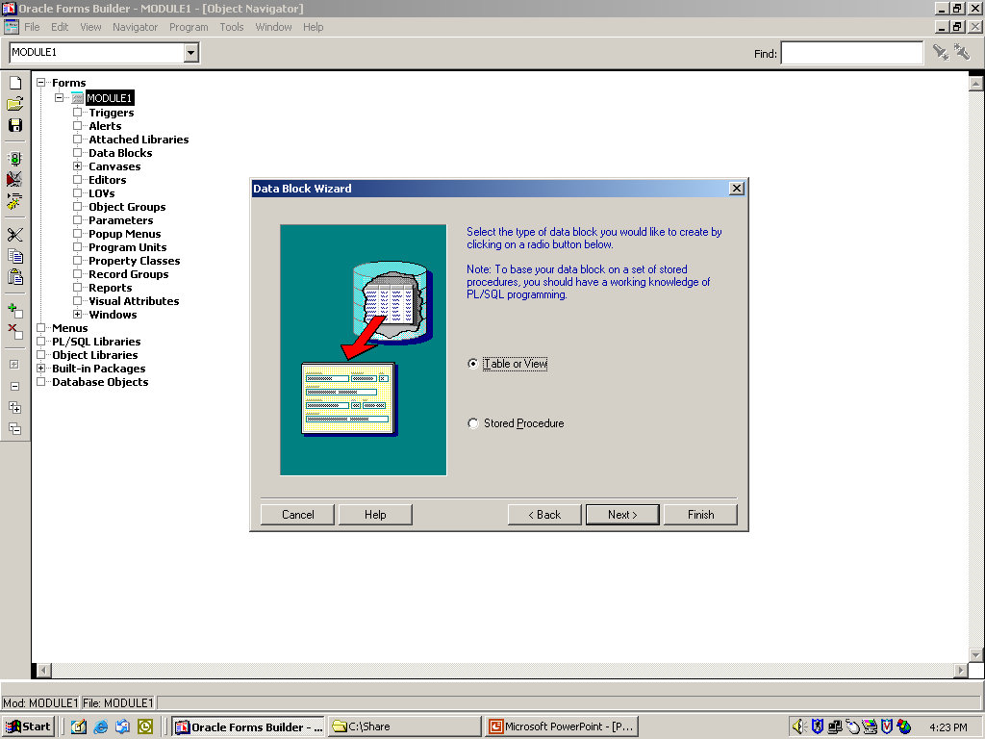
Create New Form using Data Block Wizard

Slide 23
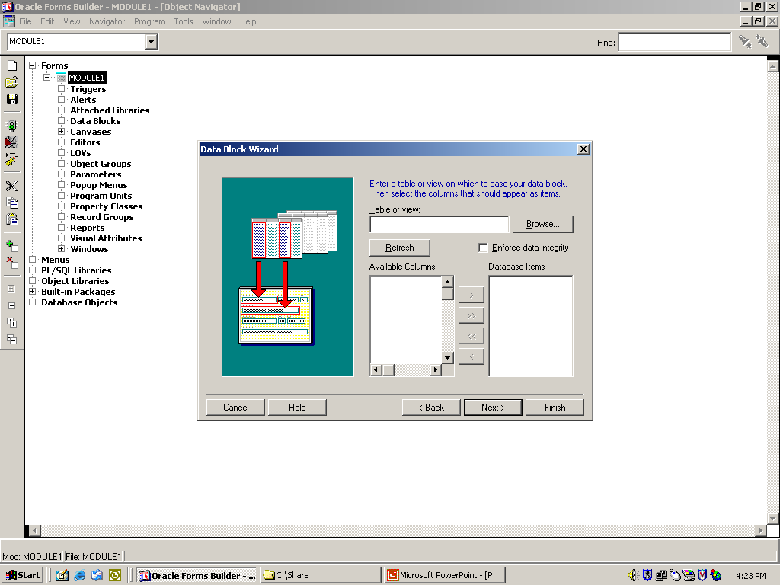
Create New Form using Data Block Wizard

Slide 24
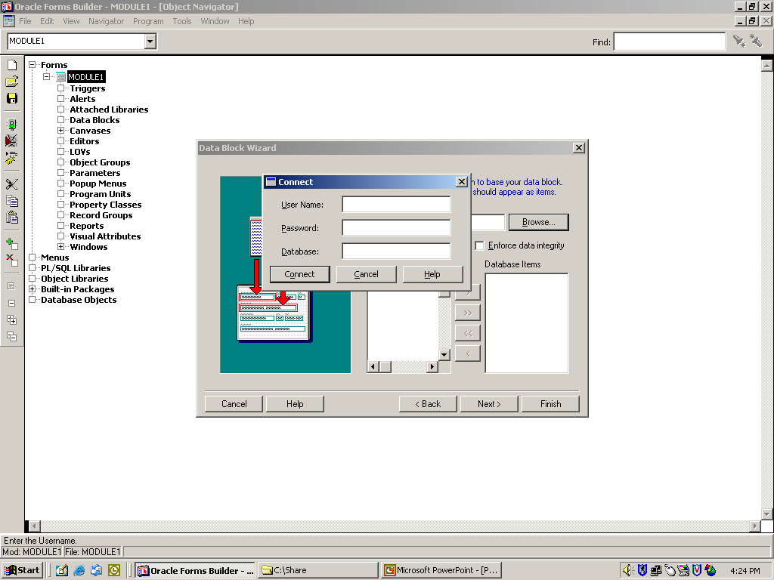
Create New Form using Data Block Wizard

Slide 25

Create New Form using Data Block Wizard

Slide 26
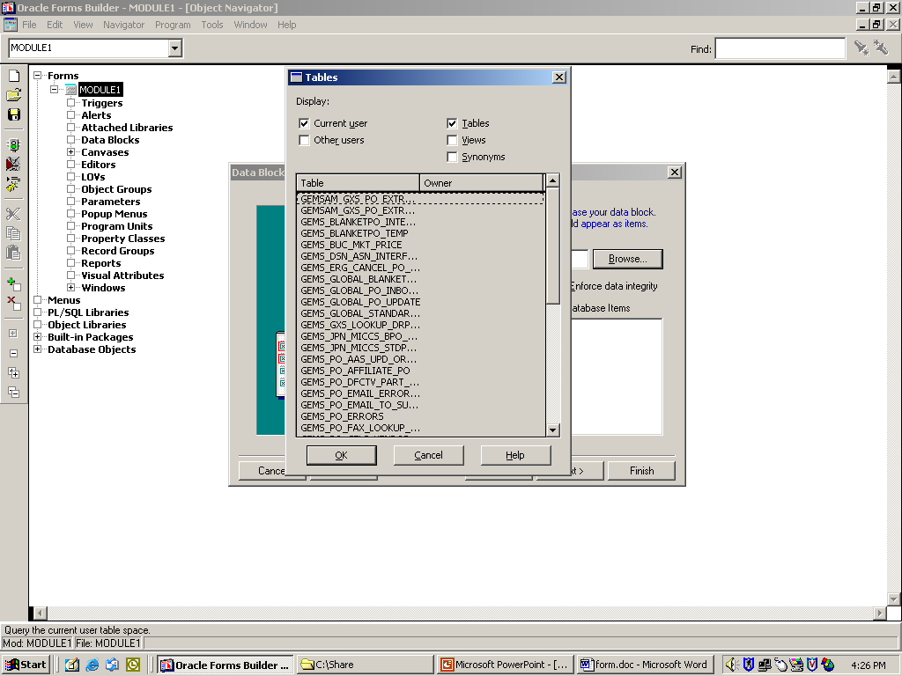
Create New Form using Data Block Wizard

Slide 27
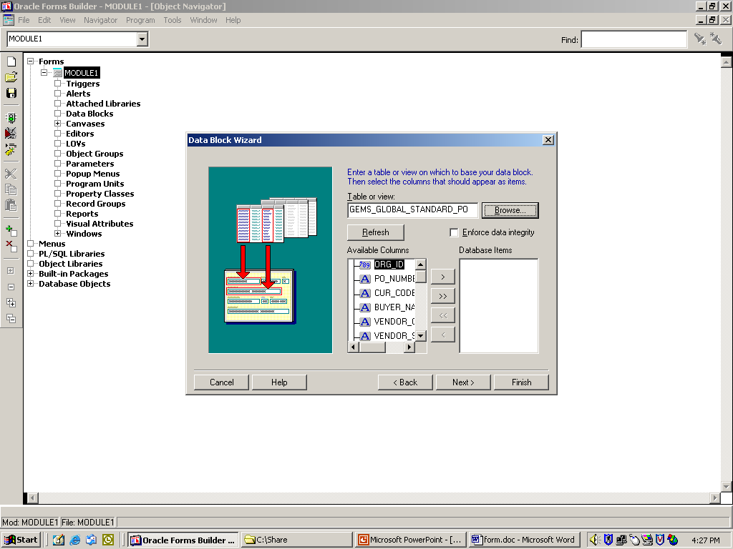
Create New Form using Data Block Wizard

Slide 28
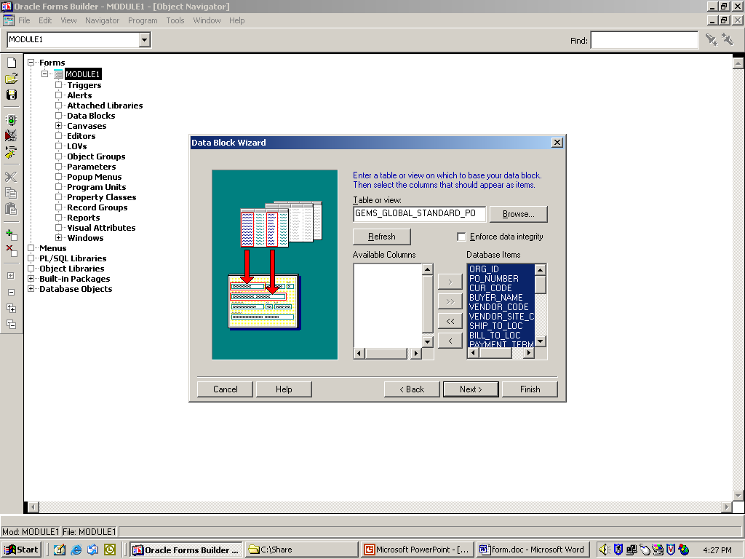
Create New Form using Data Block Wizard

Slide 29
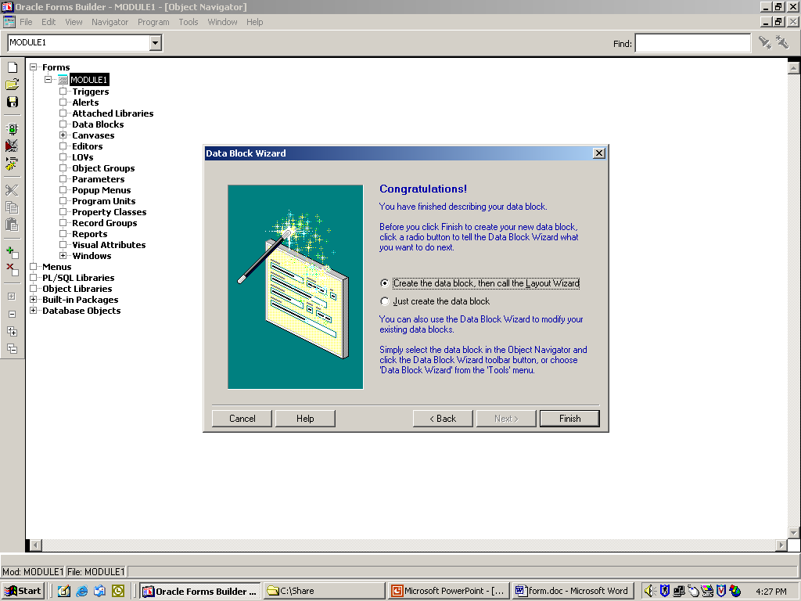
Create New Form using Data Block Wizard

Slide 30
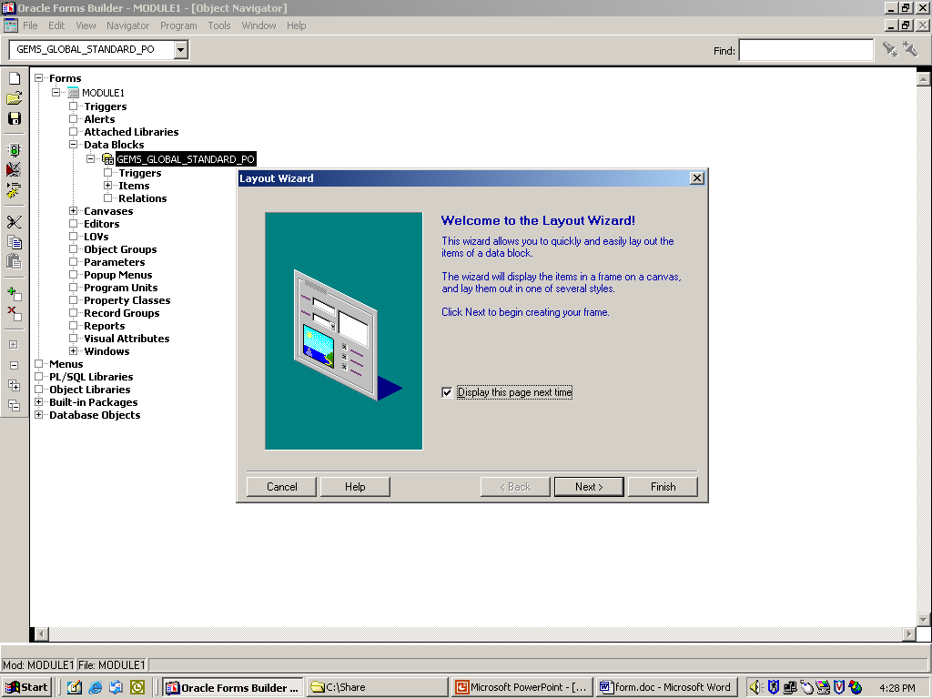
Create New Form using Data Block Wizard

Slide 31
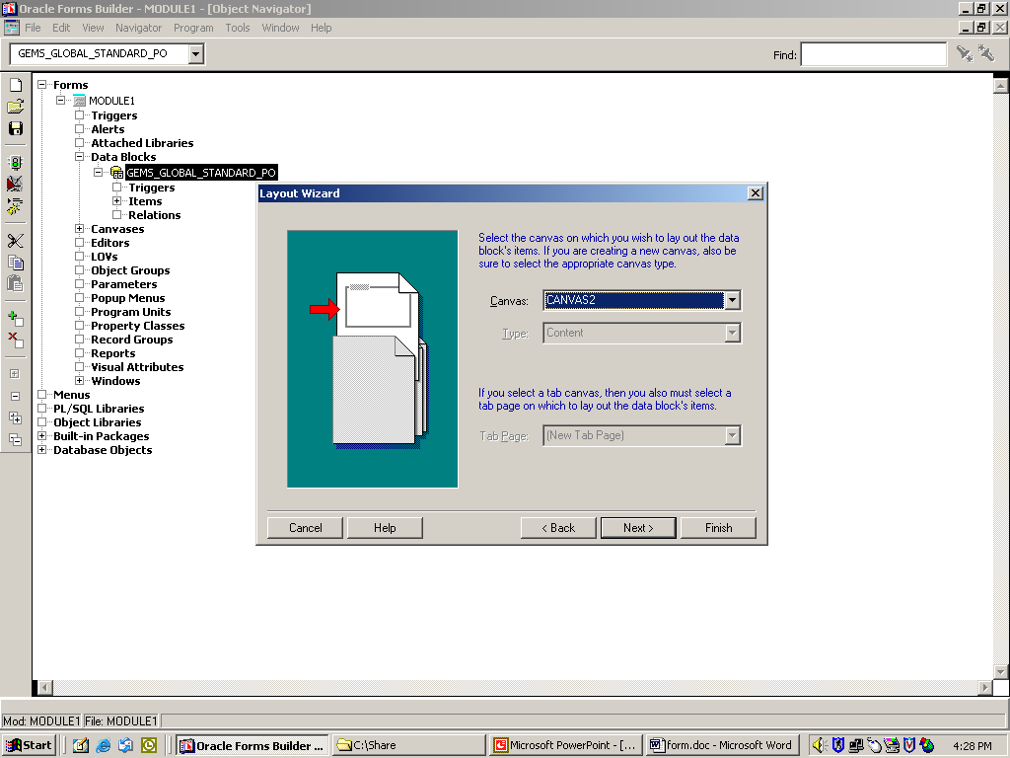
Create New Form using Data Block Wizard

Slide 32
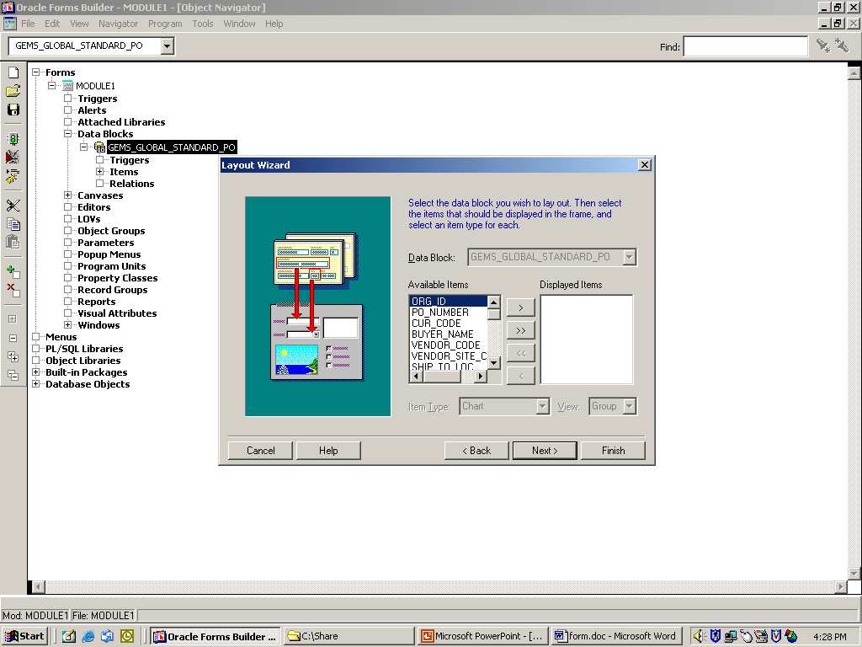
Create New Form using Data Block Wizard

Slide 33
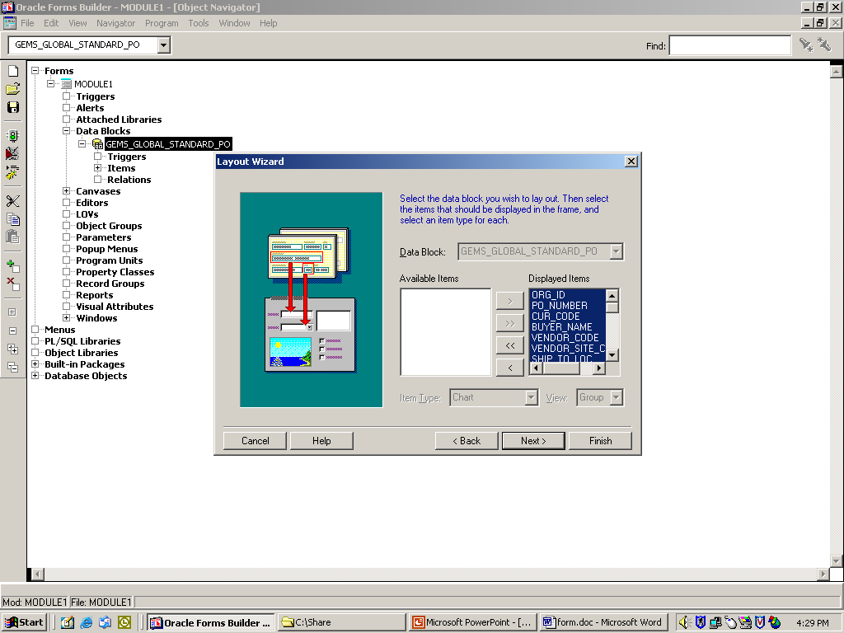
Create New Form using Data Block Wizard

Slide 34
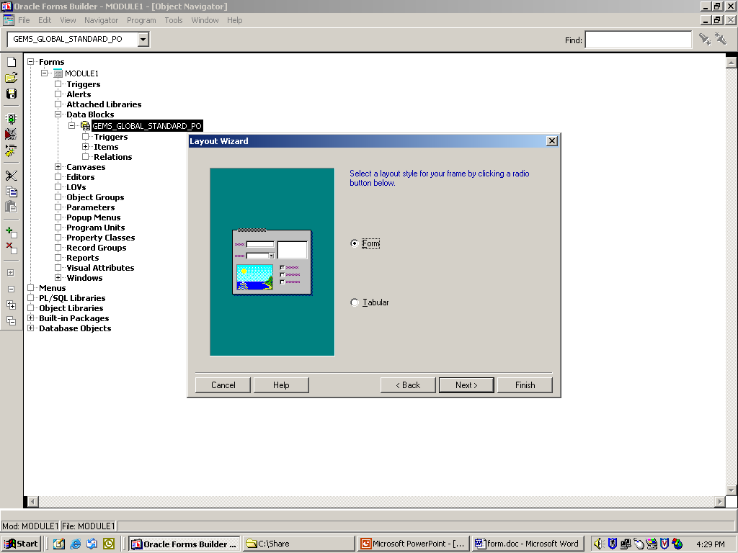
Create New Form using Data Block Wizard

Slide 35
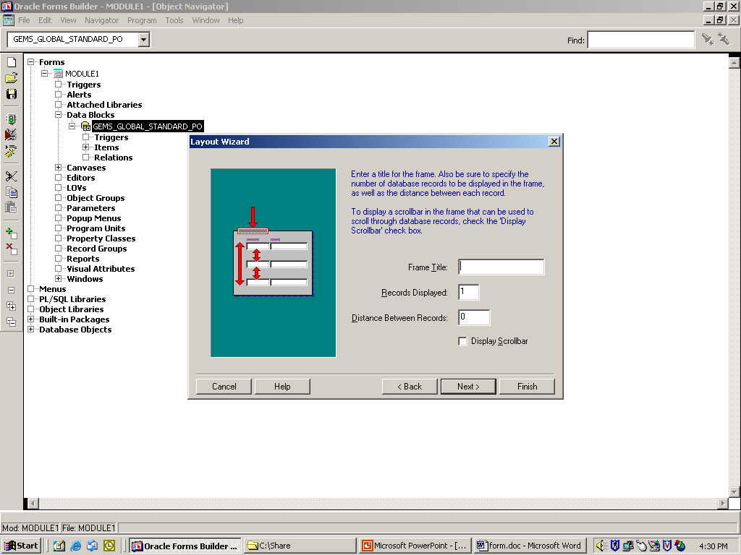
Create New Form using Data Block Wizard

Slide 36
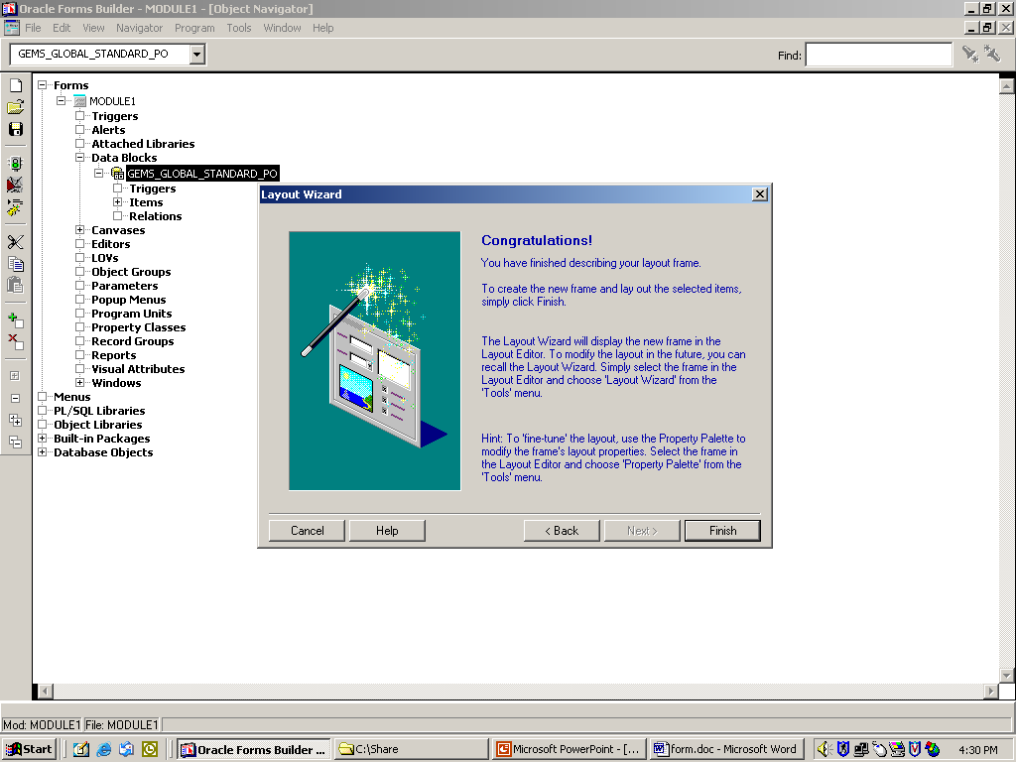
Create New Form using Data Block Wizard

Slide 37
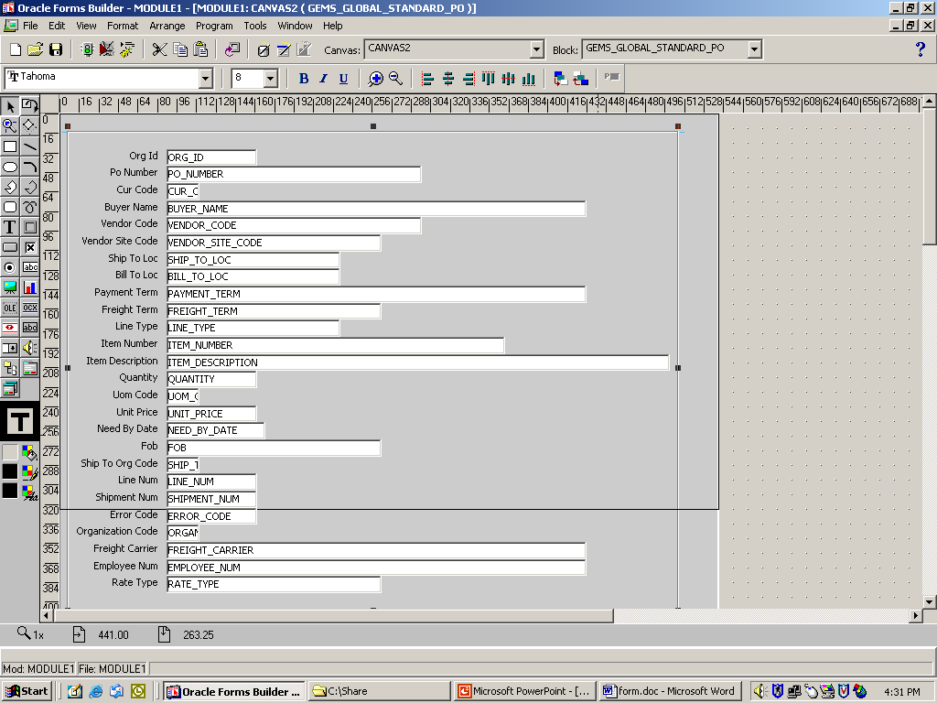
Create New Form using Data Block Wizard

Slide 38
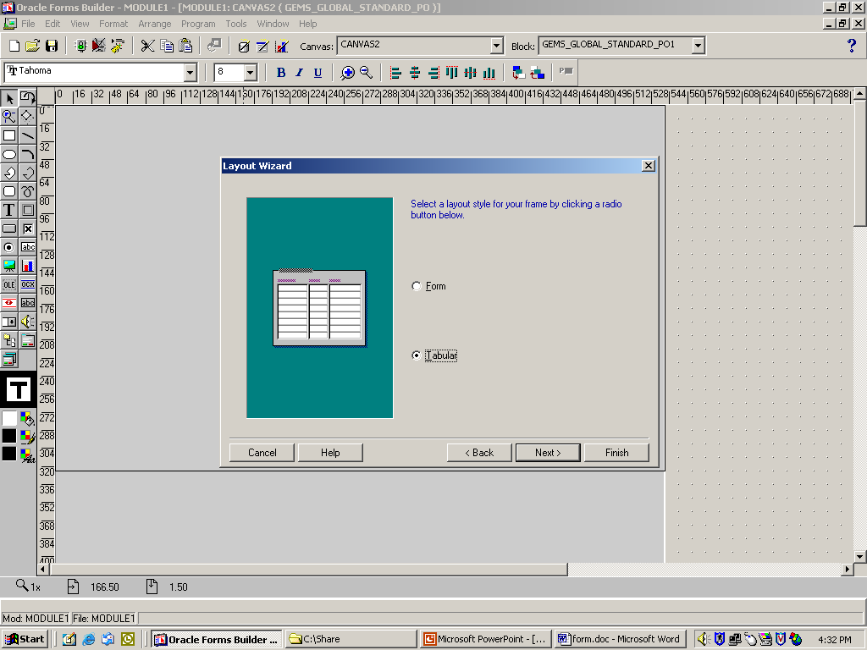
Create New Form using Data Block Wizard

Slide 39
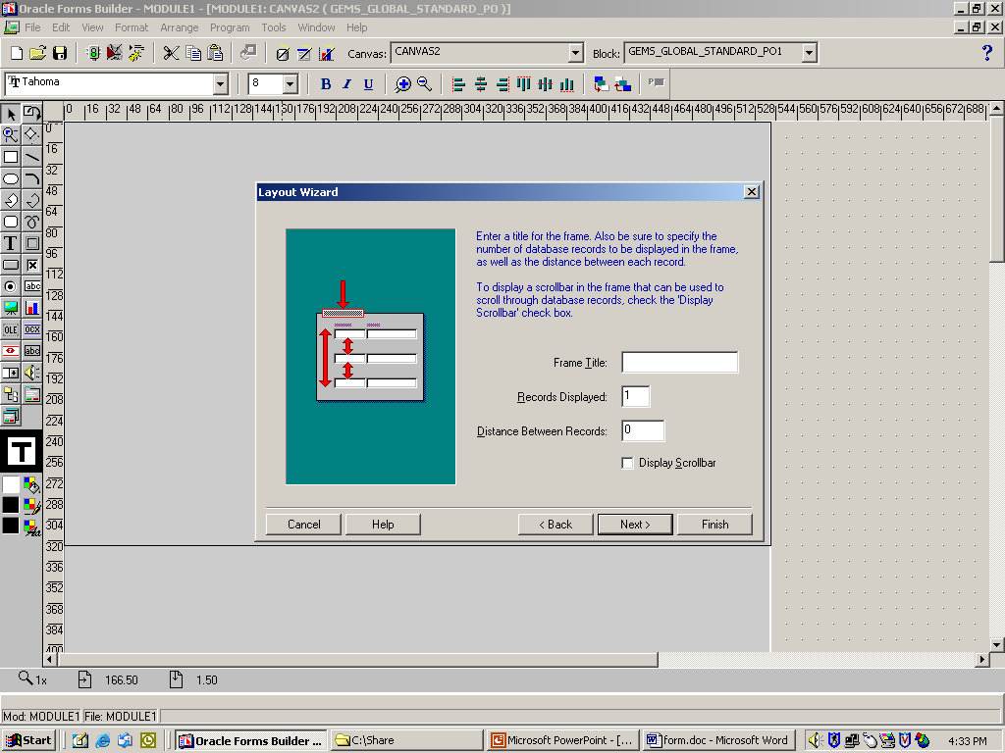
Create New Form using Data Block Wizard

Slide 40
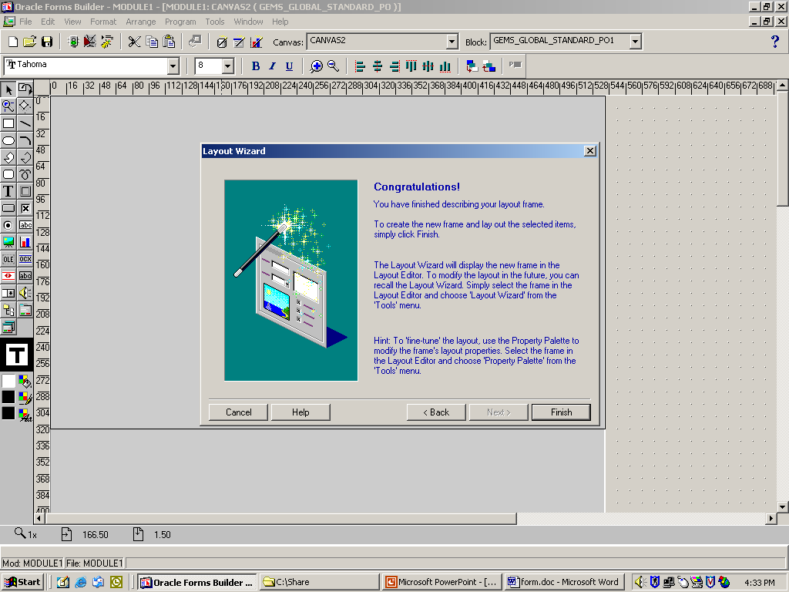
Create New Form using Data Block Wizard

Slide 41
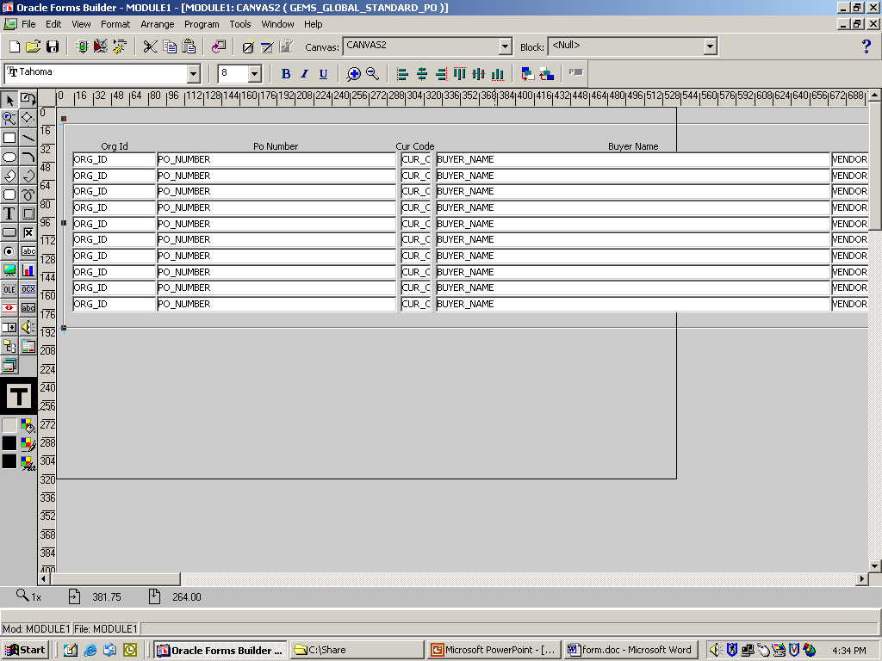
Create New Form using Data Block Wizard

Slide 42
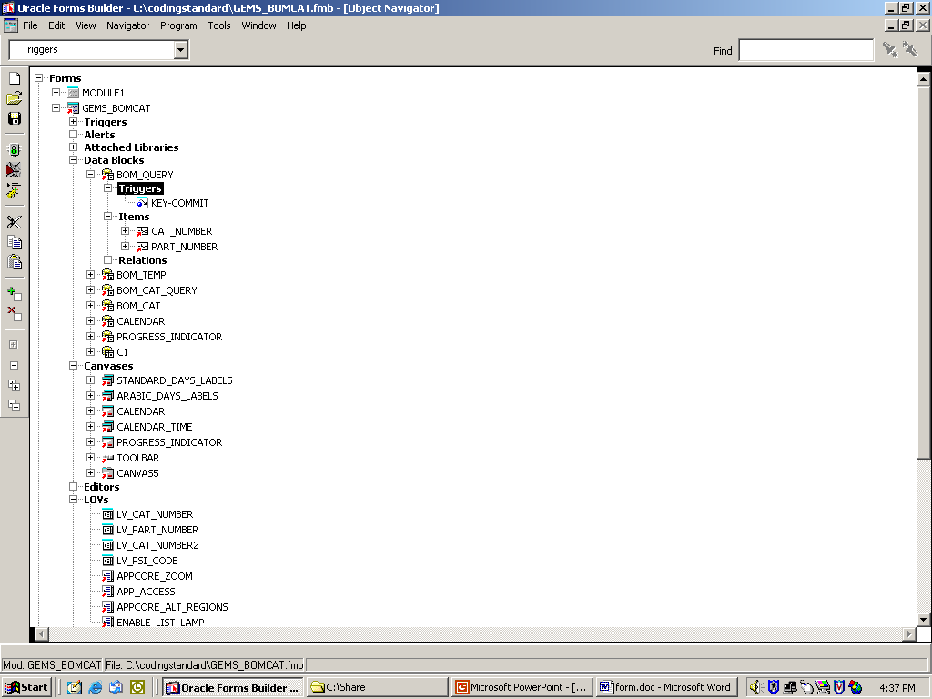
Create New Form using Data Block Wizard

Slide 43
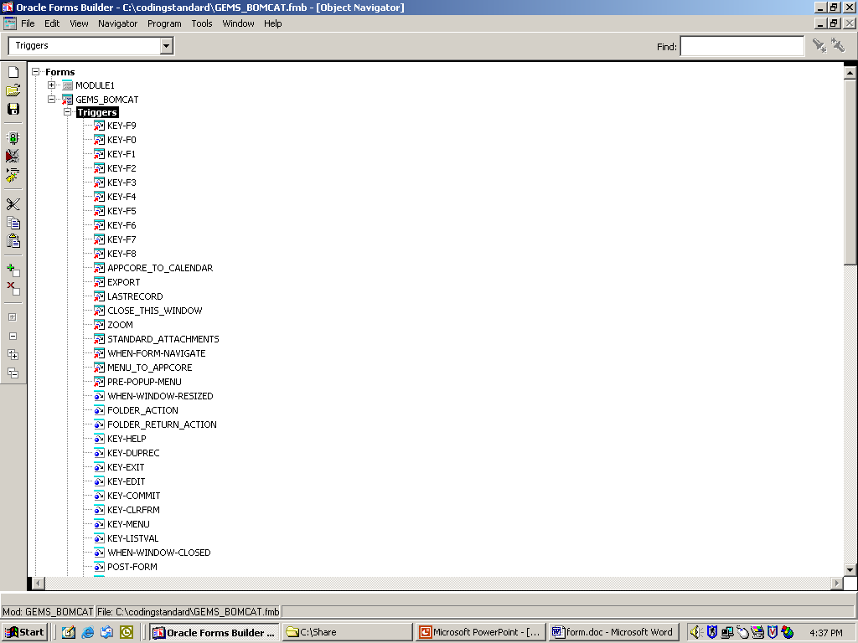
Create New Form using Data Block Wizard

Slide 44
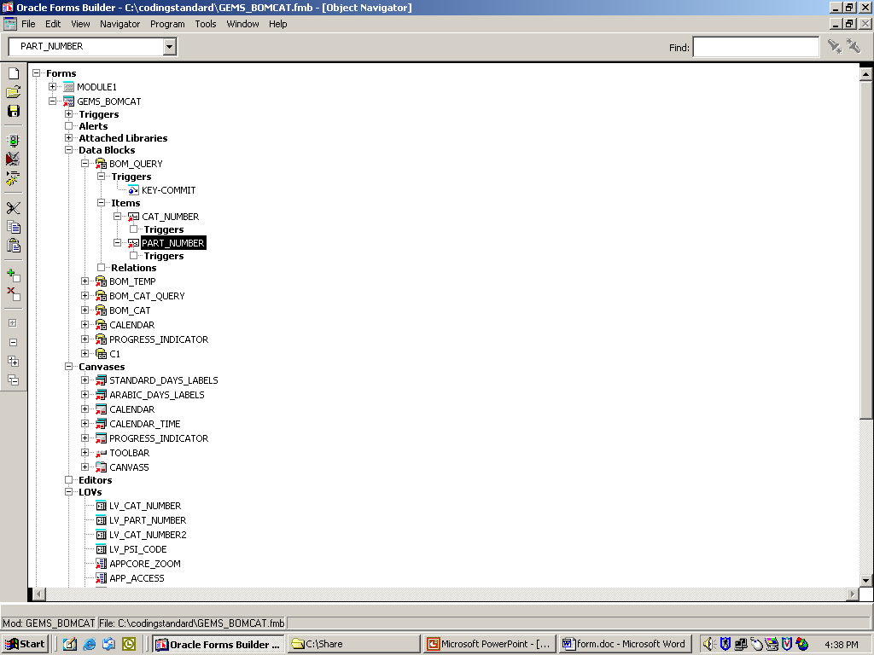
Create New Form using Data Block Wizard

Slide 45
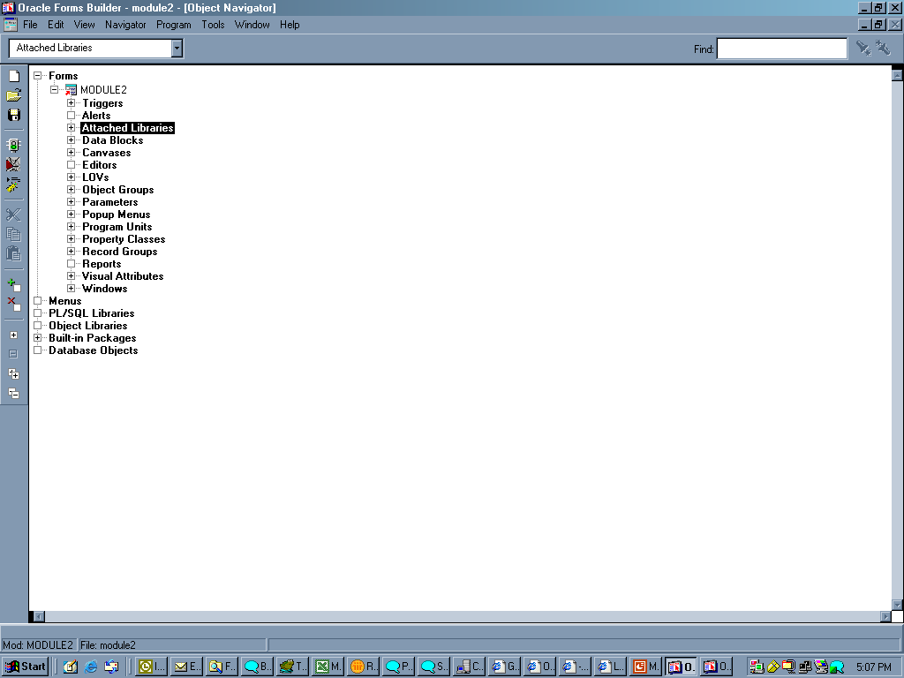
Create New Form using Template

Slide 46
Create New Form using Template
How to create different types of Canvases:
    Tab Canvas
    Stacked Canvas

Slide 47
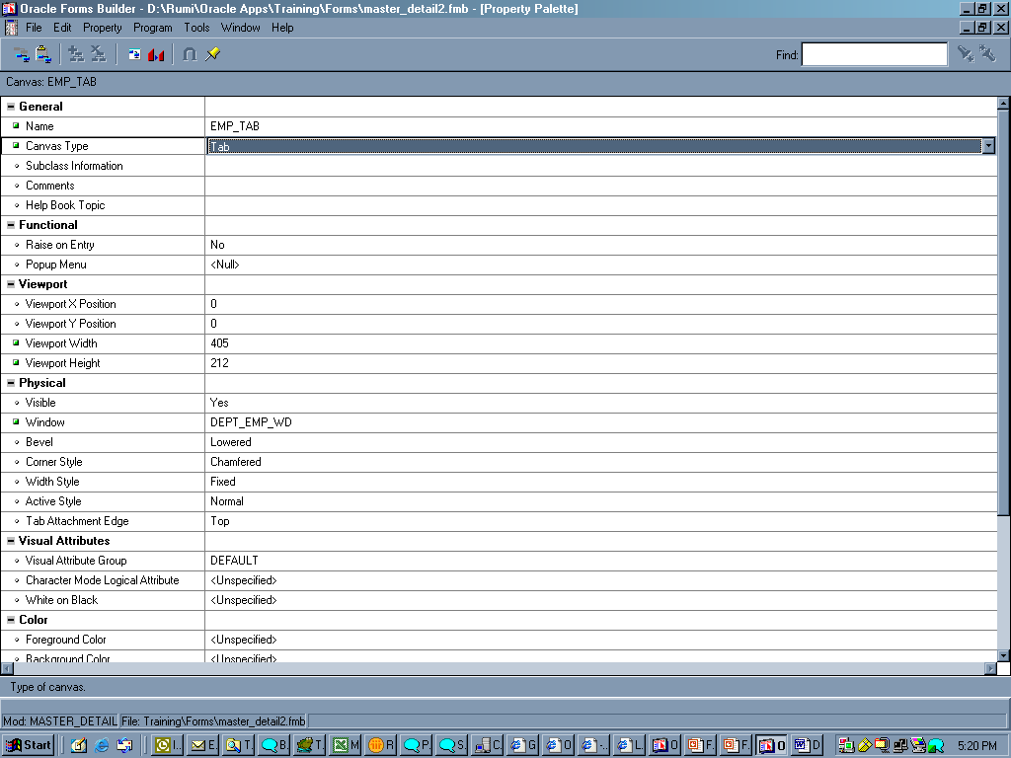
Create New Form using Template
The canvas should be TAB

Slide 48
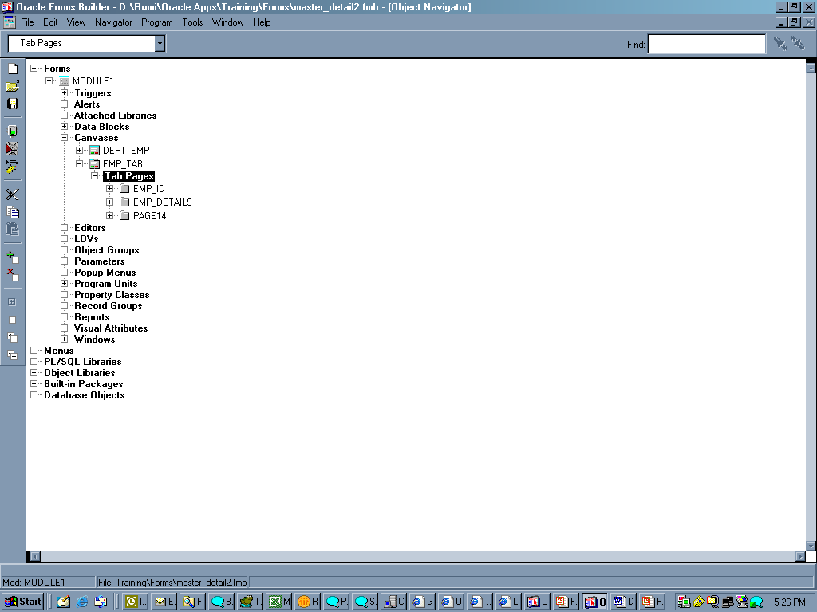
Create New Form using Template
These are the TAB pages
The Number of TAB pages
can be increased by
creating new TABs from here

Slide 49
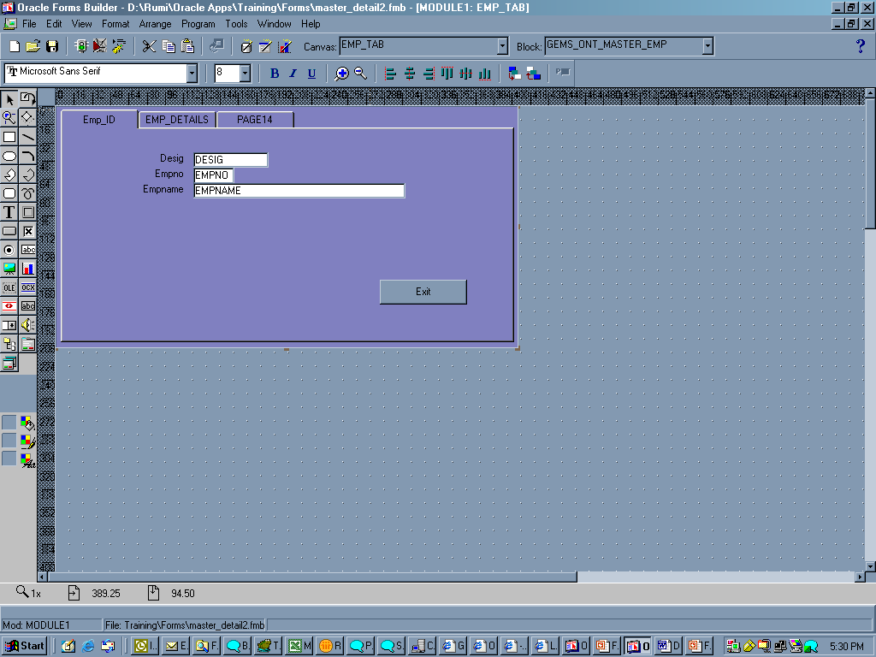
Create New Form using Template

Slide 50
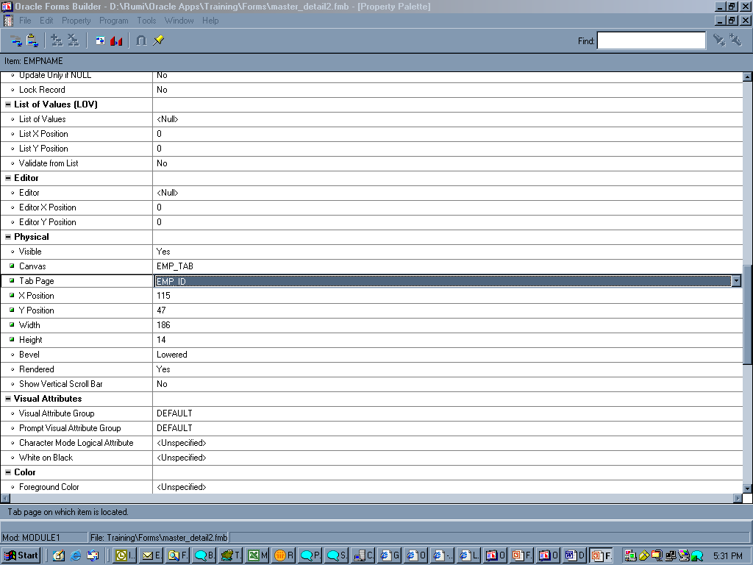
Create New Form using Template
Select Canvas and TAB Canvas

Slide 51
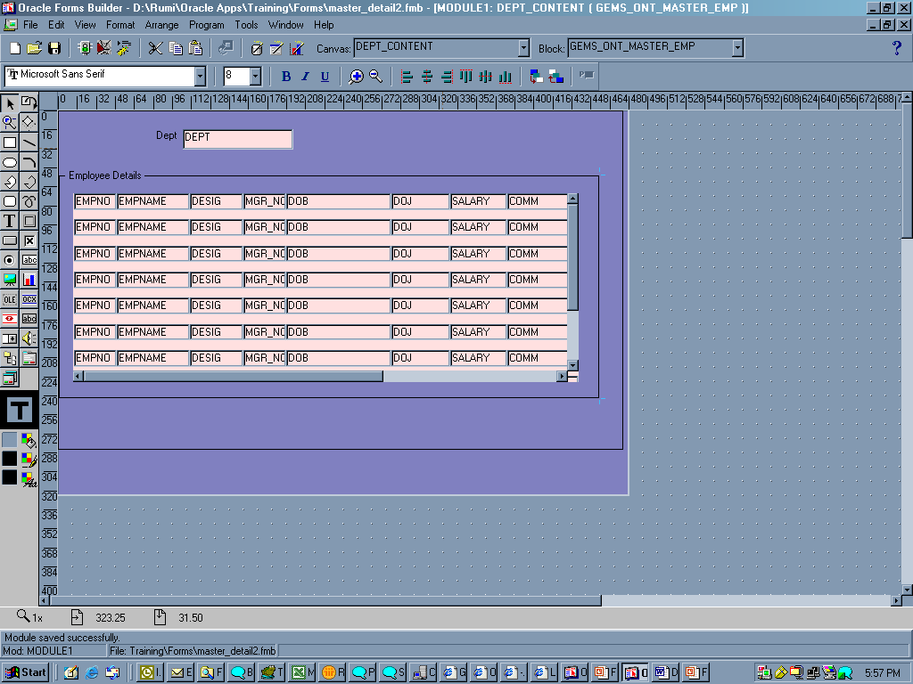
Create New Form using Template
Stacked Canvas
Content canvas
Stacked canvas

Slide 52
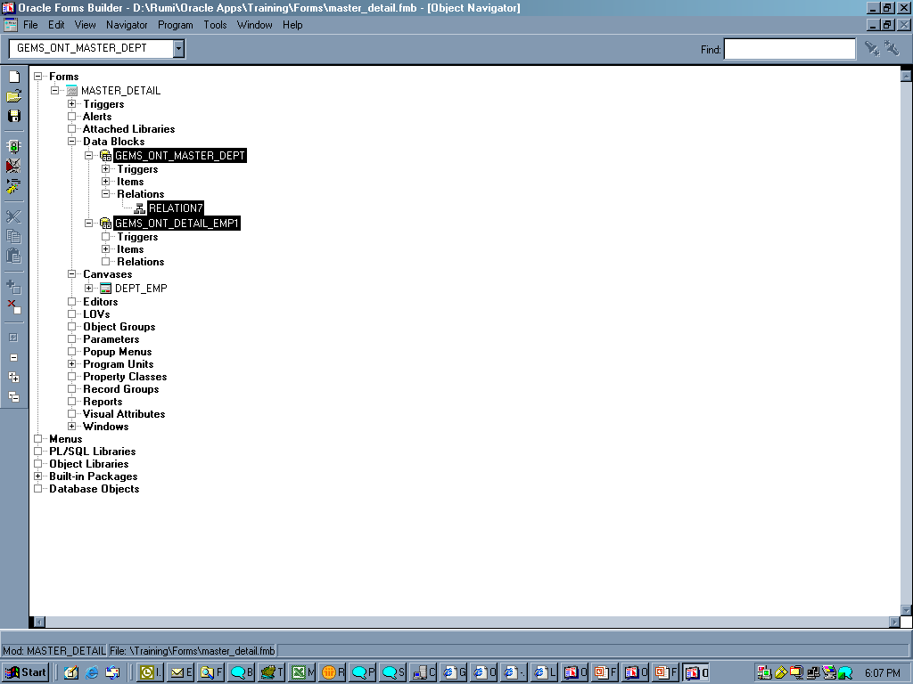
Create New Form using Template
Create a Relation in the Master Data Block. The Detail Data Block should have been created prior to it

Slide 53
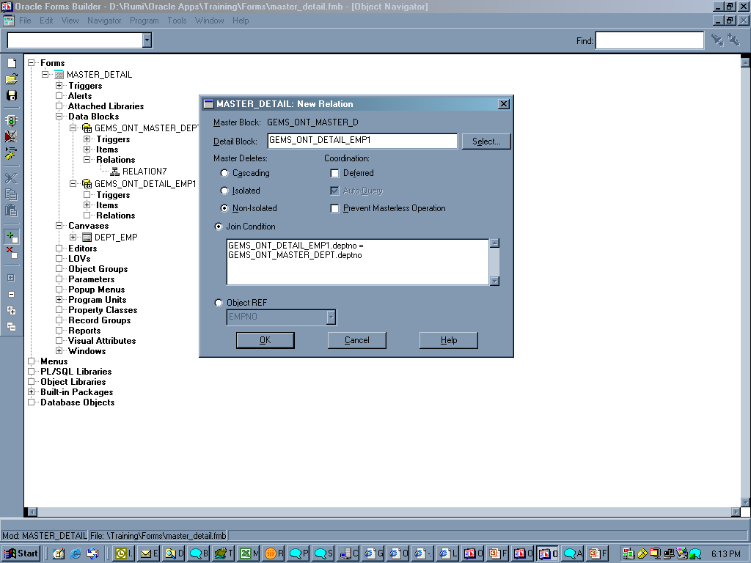
Create New Form using Template

Slide 54
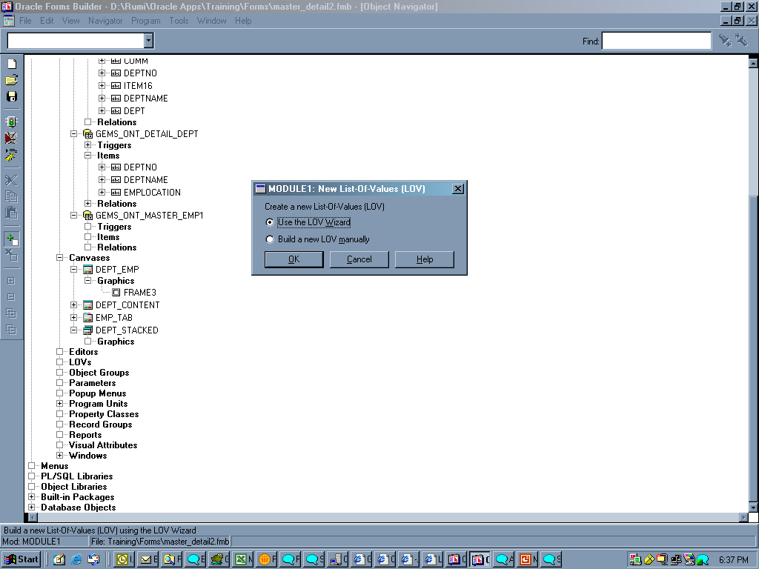
Create New Form using Template – LOV Creation

Slide 55
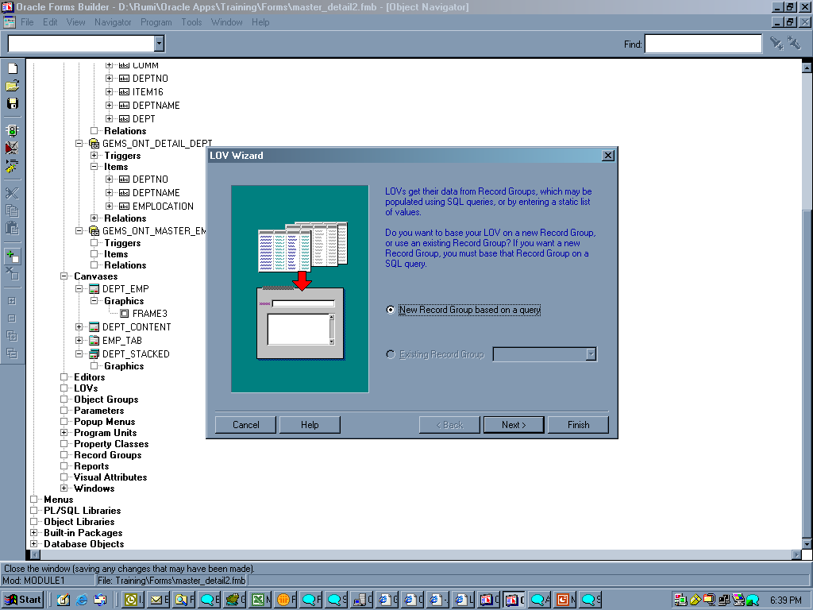
Create New Form using Template – LOV Creation

Slide 56
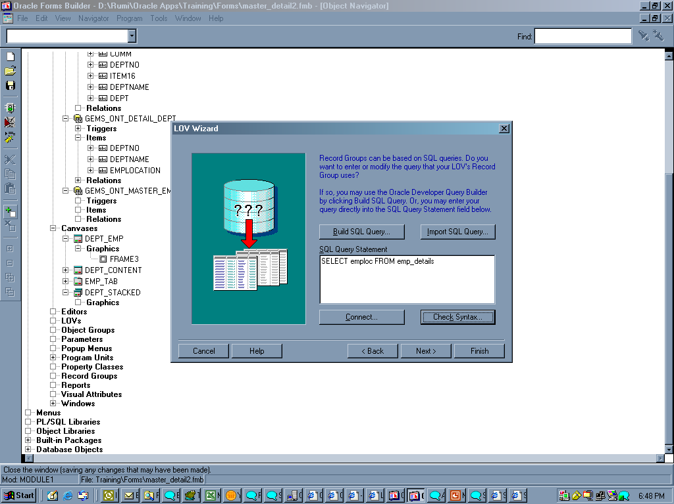
Create New Form using Template – LOV Creation

Slide 57
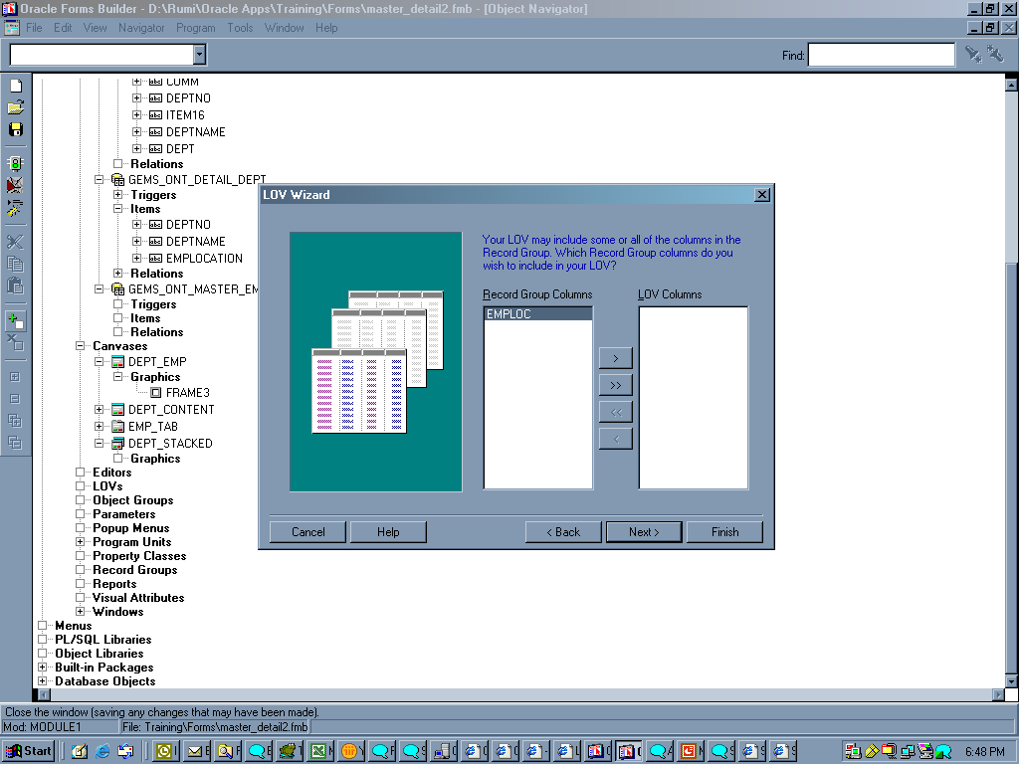
Create New Form using Template – LOV Creation

Slide 58
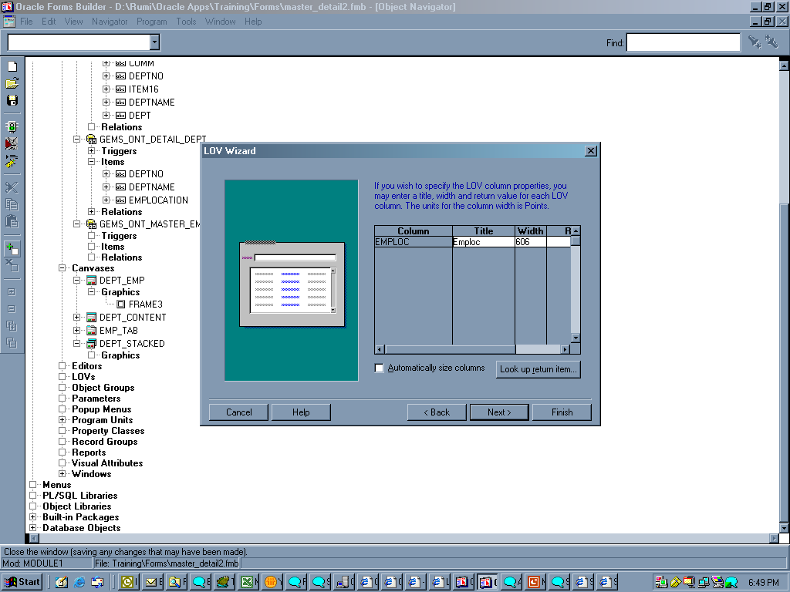
Create New Form using Template – LOV Creation

Slide 59
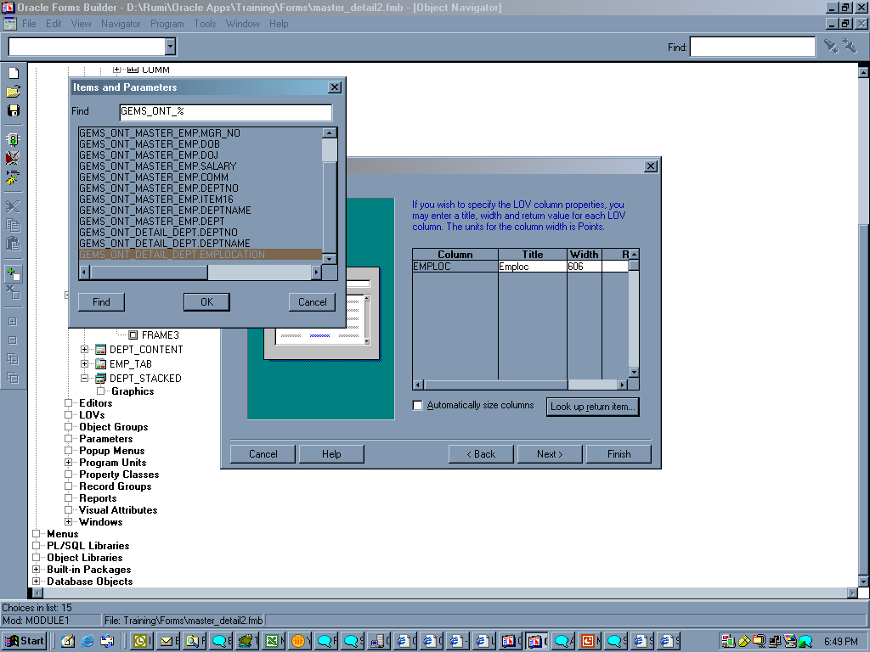
Create New Form using Template – LOV Creation

Slide 60
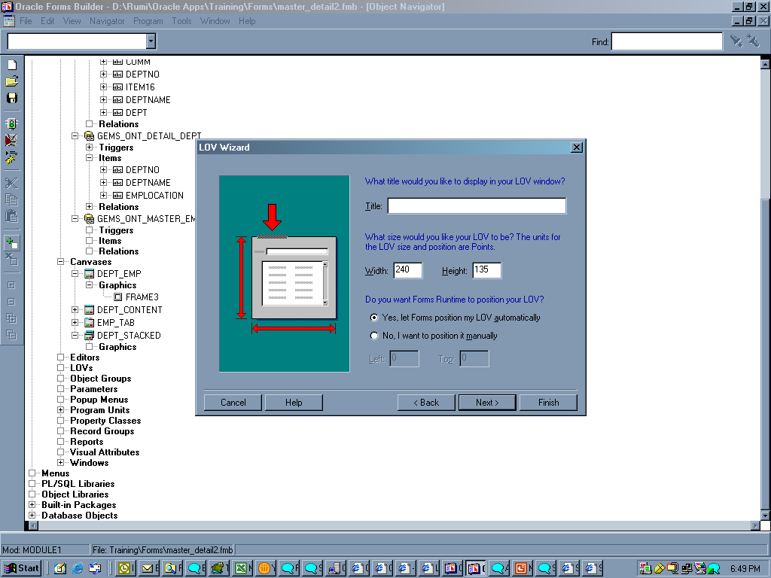
Create New Form using Template – LOV Creation

Slide 61
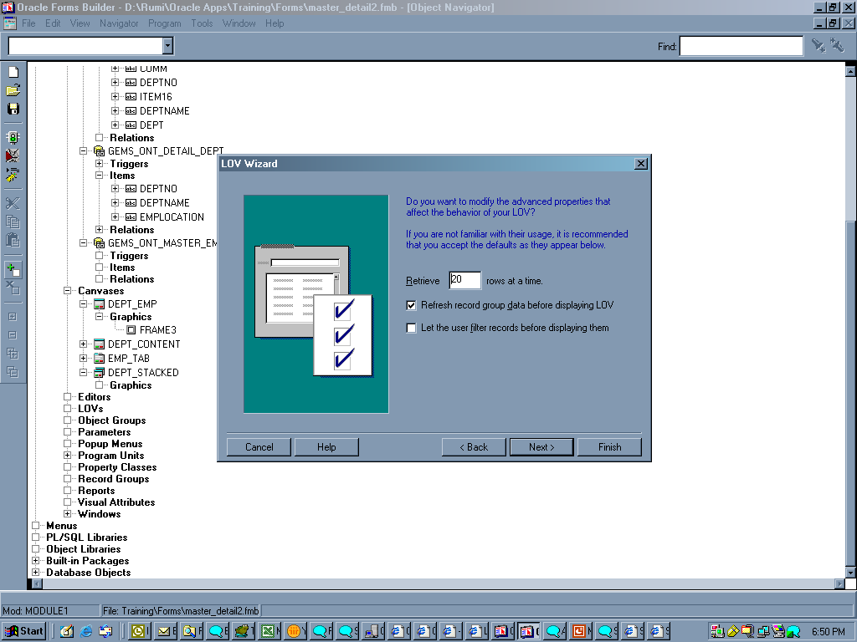
Create New Form using Template – LOV Creation

Slide 62
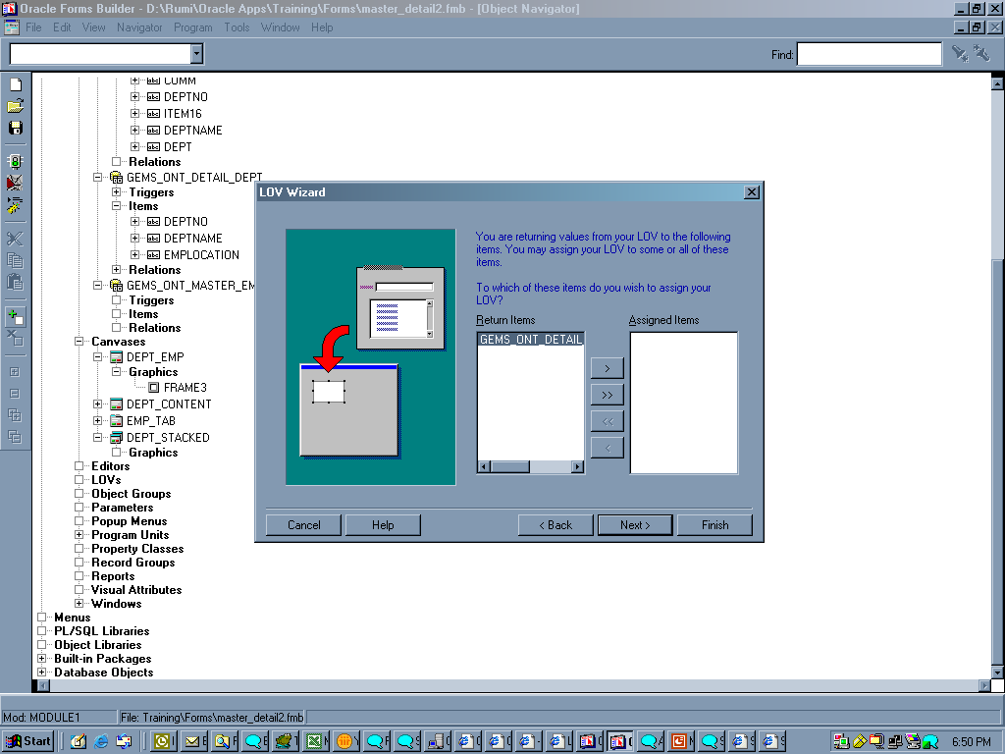
Create New Form using Template – LOV Creation

Slide 63
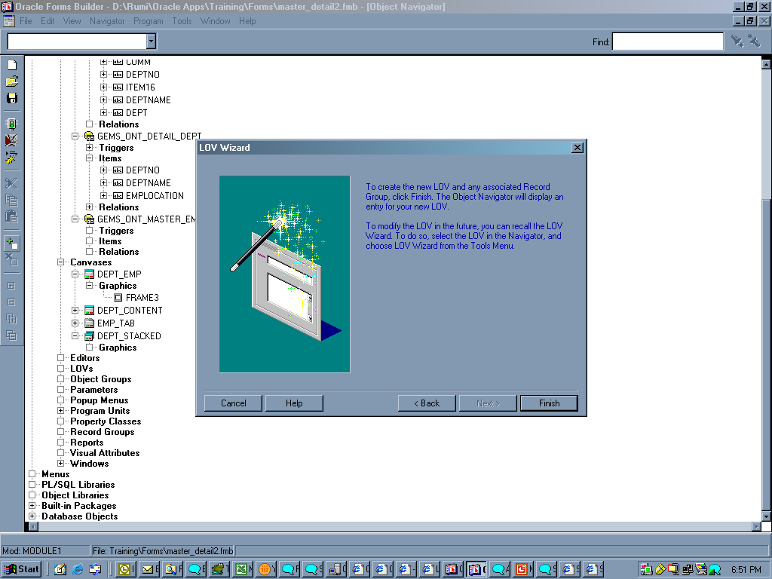
Create New Form using Template – LOV Creation

Slide 64
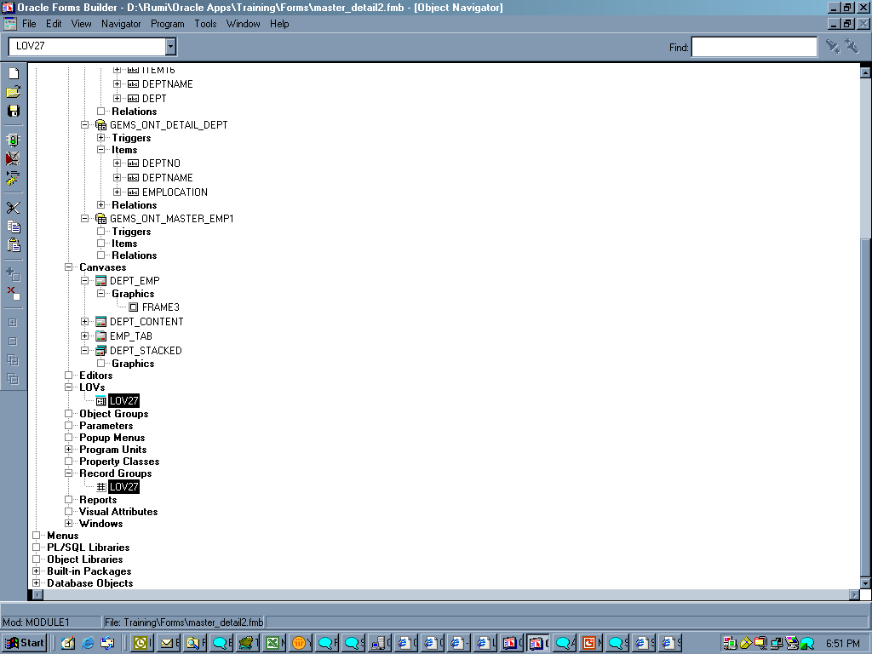
Create New Form using Template – LOV Creation

Slide 65
Summary
Q And A
Thank You

